Slide 1
Activity Diagrams

Slide 2
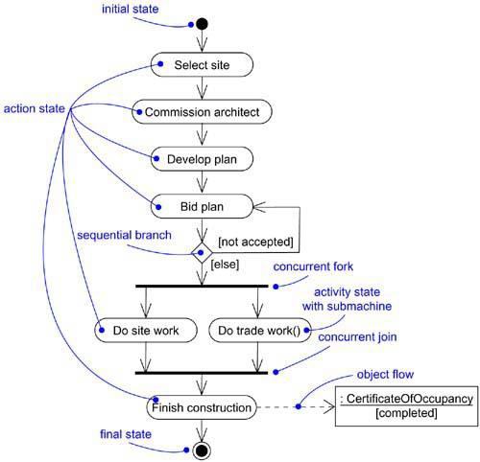
Activity Diagrams

Slide 3
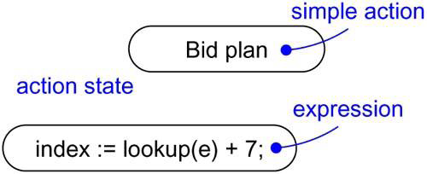
Action States

Slide 4
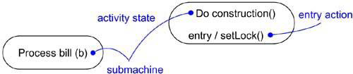
Activity States

Slide 5
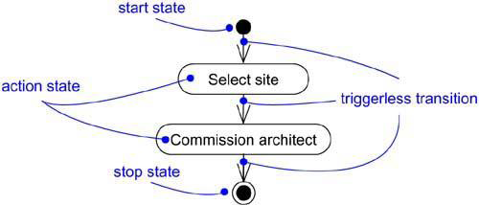
Triggerless Transitions

Slide 6
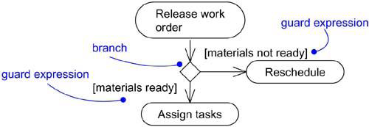
Branching

Slide 7
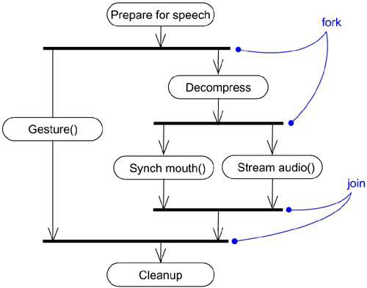
Forking and Joining

Slide 8
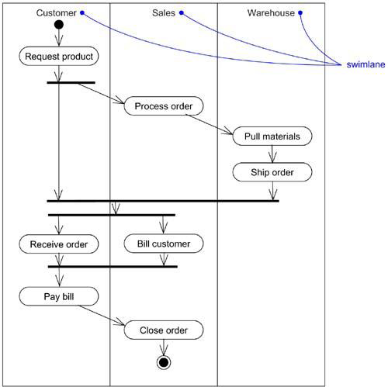
Swimlanes

Slide 9
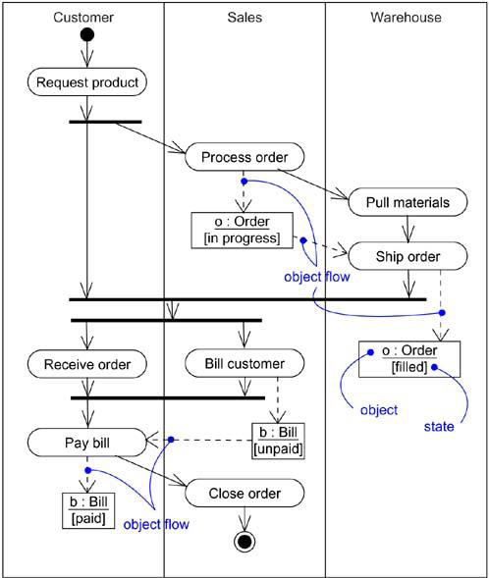
Object Flow

Slide 10
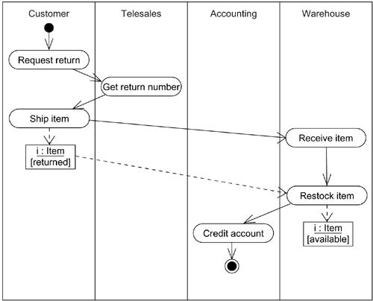
Modeling a Workflow

Slide 11
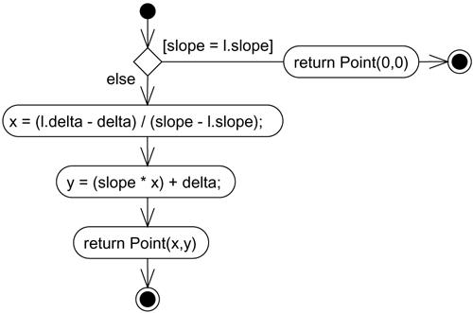
Modeling an Operation

Slide 12
Forward and Reverse Engineering
Point Line::intersection (l : Line) {
if (slope == l.slope) return Point(0,0);
int x = (l.delta - delta) / (slope - l.slope);
int y = (slope * x) + delta;
return Point(x, y);
}

